Slide 1



PrognosAI: AI-Driven Predictive Maintenance System Using Time-Series Sensor Data

Slide 2

Table of Contents
Milestone 1: Data Preparation and Feature Engineering
1
Milestone 2: Model Development and Training
2
Milestone 3: Model Evaluation and Performance Assessment
3
Milestone 4: Risk Thresholding and Maintenance Alerts
4
Milestone 5: Visualization Dashboard Development
5

Slide 3
Agenda
The project focuses on predicting the Remaining Useful Life (RUL) of industrial machinery like turbines and pumps using multivariate time-series sensor data and LSTM deep learning models. This enables proactive maintenance, reducing unplanned downtime and optimizing asset utilization. The workflow includes data ingestion, feature engineering, model training, risk thresholding, and interactive dashboards for monitoring. The project showcases the effective application of AI-driven pattern recognition for real-world predictive maintenance in critical industrial settings..

Slide 4


Milestone 1: Data Preparation and Feature Engineering
Objective
Load, clean, and preprocess the NASA CMAPSS sensor dataset.
Generate rolling window sequences of sensor readings.
Compute Remaining Useful Life (RUL) targets for each engine cycle.
.
Key Steps
Data Loading & Cleaning:
Imported raw sensor data CSV and identified the time or cycle column.
Handled missing values using median imputation for numerical sensor features.
RUL Calculation:
Created overlapping sequences (window size of 50 cycles) sliding by stride 1.
Extracted sensor features and label (RUL) for each sequence.
Batch Processing & Verification:
Processed data in batches for efficient handling.
Verified sensor value distributions and RUL ranges within batches.

Slide 5

Milestone 2: Model Development and Training
Objective
Build and train a deep learning model to predict the Remaining Useful Life (RUL) from sensor data sequences.
Model Architecture:
Used a Sequential deep learning model with these layers:
Two stacked LSTM layers (first with 128 units returning sequences, second with 64 units).
Dropout layers (0.2 rate) after each LSTM for regularization.
Dense layers: one hidden with 32 units (ReLU activation), output layer with 1 unit (linear activation) for RUL prediction.

Slide 6



Training Details:
Loss function: Mean Absolute Error (MAE).
Optimizer: Adam with learning rate 0.001.
Metrics: Mean Squared Error (MSE).
Training data split: 80% train, 20% validation.
Batch size: 64.
Epochs: Up to 100 with early stopping patience of 10 (restores best weights).
Learning rate reduction on plateau (factor 0.5, patience 5).
Workflow:
Preprocessed sequences (from Milestone 1) fed into the model.
Model trained with callbacks for adaptive learning and early stopping.
Evaluated performance with validation MAE and MSE.
Output predictions compared visually against actual RUL values.

Slide 7

Milestone 3: Model Evaluation and Performance Assessment
Objective:
Assess prediction accuracy of the trained model on the test dataset.
Key Metrics:
Root Mean Square Error (RMSE): 15.9971 cycles.
Mean Absolute Error (MAE): 13.1381 cycles.
R² Score: 0.6958 (explains nearly 70% variance in RUL).

Slide 8
Evaluation Process:
Generated predictions on the held-out test set.
Compared predicted vs actual RUL with scatter plots and time series visualization.
Analyzed prediction error distribution showing mean error and standard deviation.
Checked for overfitting by comparing training and validation losses across epochs
Outcome:
Model demonstrates good predictive performance with acceptable error margins.
Provides reliable sequential RUL estimations for maintenance scheduling decisions.

Slide 9


Milestone 4: Risk Thresholding and Maintenance Alerts
Objective:
Define thresholds for RUL values to trigger warning and critical maintenance alerts.
Alert Thresholds:
WARNING threshold: 40 cycles.
CRITICAL threshold: 20 cycles.
Alert System Workflow:
Predicted RUL values classified into normal, warning, or critical alert levels.
Monitored distribution of alerts on test samples.
Visualized alert frequency with bar charts and RUL distribution with threshold markers.

Slide 10
Alert Performance:
Normal operation detected in ~60.5% of predictions.
No warning alert triggered (0%).
Critical alerts triggered in ~39.5% of predictions.
Outcome:
Alerting mechanism enables proactive maintenance planning.
Highlights critical machinery components approaching failure margins.

Slide 11
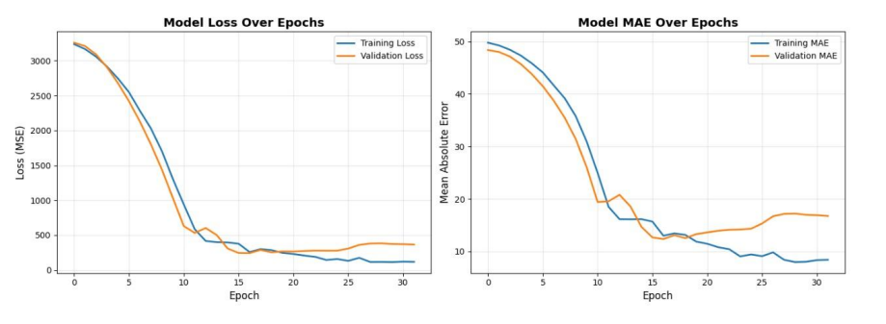
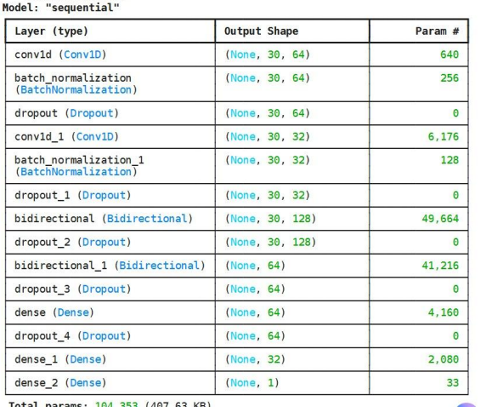
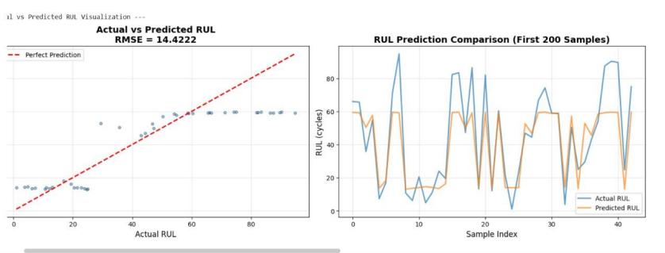

Output for Milestone 3 and 4:

Slide 12
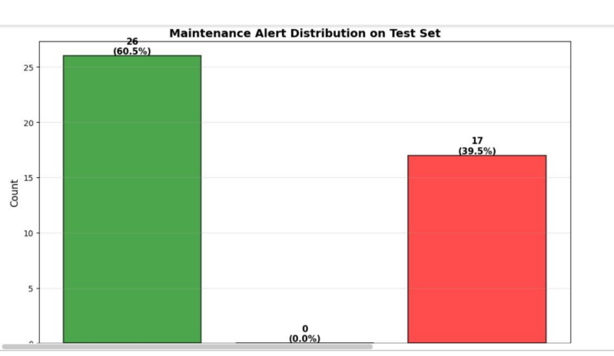
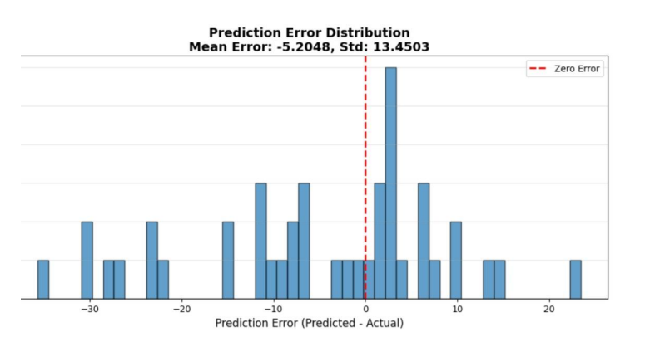
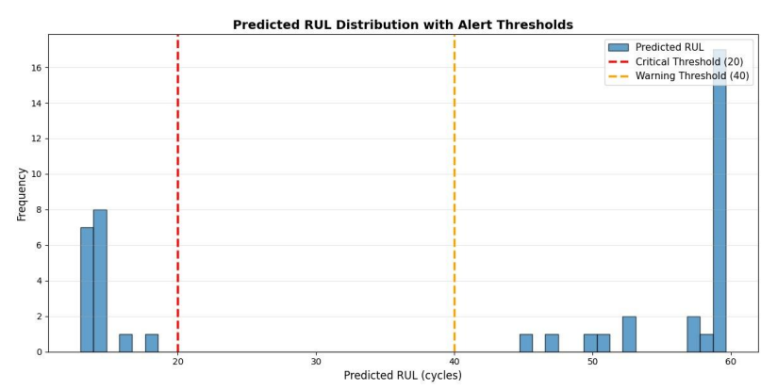

Slide 13

Milestone 5: Visualization Dashboard Development
Objective:
Develop an interactive dashboard to visualize RUL predictions, alerts, and model performance.
Provide an intuitive user interface for monitoring machine health and maintenance decisions.
Features:
Display RUL trends over time with interactive charts.
Show alert zones categorized by Normal, Warning, and Critical levels based on thresholding.
Visualization of model evaluation metrics including training loss, MAE, and validation performance.
Provide alert distribution and confusion matrix heatmap to assess alert system accuracy.
Ability to explore actual vs predicted RUL values with optional perfect prediction reference line.
Sample maintenance alerts and full test predictions with filtering options.
Additional reports on system performance, data quality, and model configuration

Slide 14
Technology Stack:
Built with Streamlit for rapid and responsive web dashboard creation.
Used Matplotlib and Seaborn for plotting data visualizations.
Integrated data from CSV and text reports for comprehensive insights.
Deliverables:
Fully functional dashboard Python application.
Clear, actionable graphical outputs aiding proactive maintenance.
Documentation for deployment and usage.
Outcome:
Enhanced user experience in accessing critical asset health information.
Real-time visualization supports timely maintenance interventions.
Demonstrates end-to-end AI predictive maintenance solution from data to insights.

Slide 15
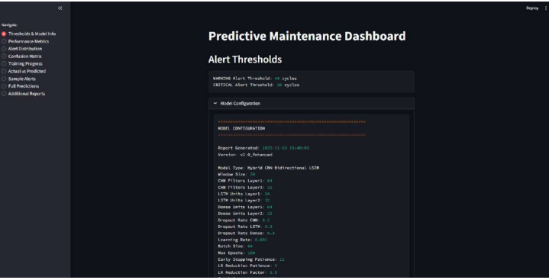
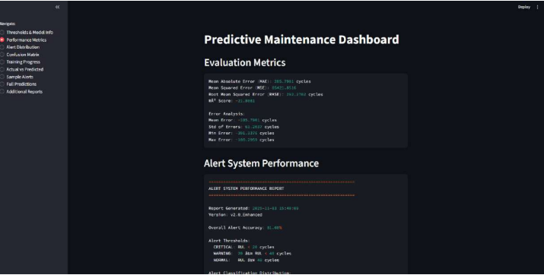
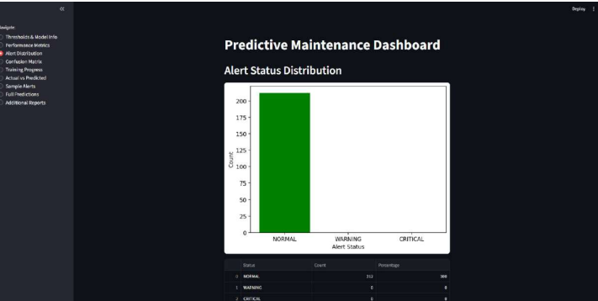
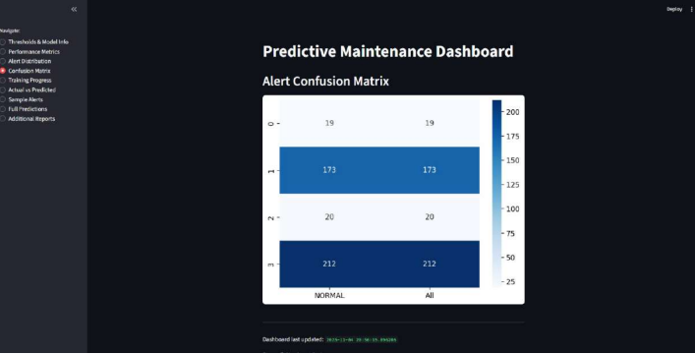
Dashboard Application Screenshot:

Slide 16

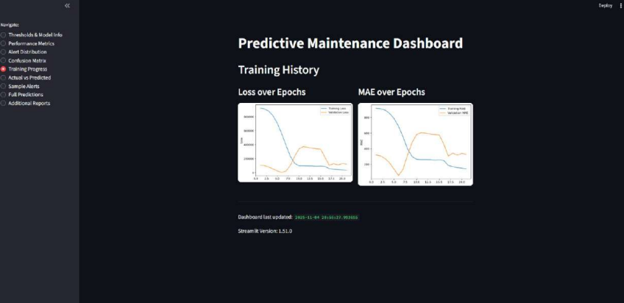
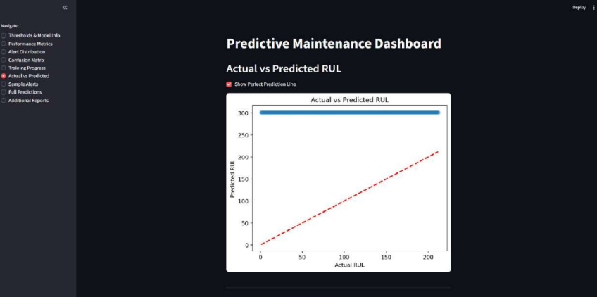
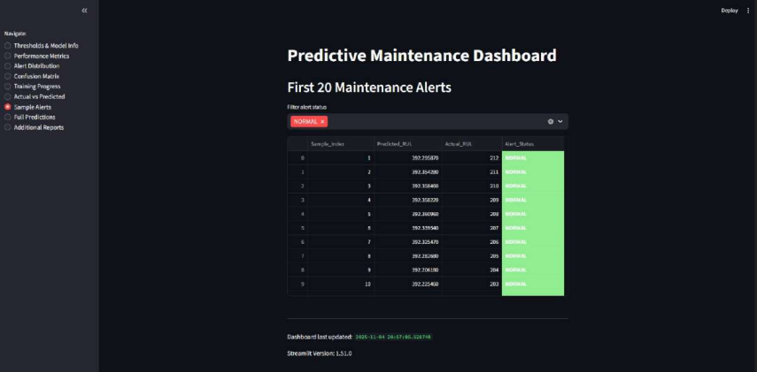
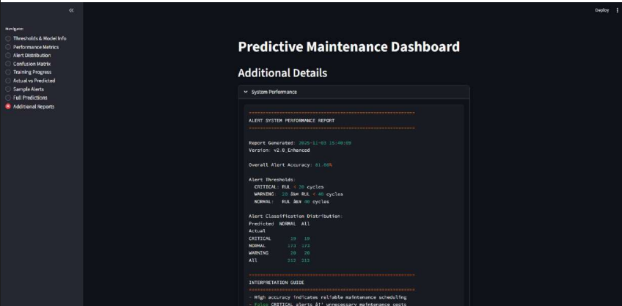

Slide 17
References
NASA. CMAPSS Turbofan Engine Dataset.
GeeksforGeeks. LSTM Neural Networks in Python. Available at: https://www.geeksforgeeks.org/deep-learning/long-short-term-memory-networks-using-pytorch/
TensorFlow Documentation. Keras API Guide. Available at: https://www.tensorflow.org/guide/keras
Scikit-learn Documentation. Data Preprocessing & Metrics Modules. Available at: https://scikit-learn.org/stable/modules/preprocessing.html
Matplotlib and Seaborn Documentation. Data Visualization Libraries in Python. Available at: https://matplotlib.org/stable/contents.html and https://seaborn.pydata.org/
NumPy Documentation. Array and Numerical Computation Library. Available at: https://numpy.org/doc/
Streamlit Documentation. Interactive Data Applications in Python. Available at: https://docs.streamlit.io/

Slide 18

Thank you!

